Slide 1
Administration
Project 3
Teammates signed up?
Checkpoint: Today
Final Submission: Friday
Discussion Questions

Slide 2
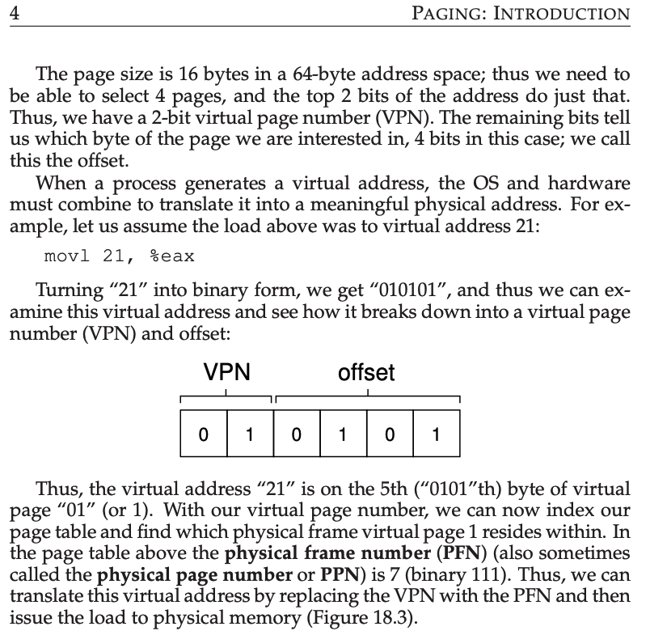
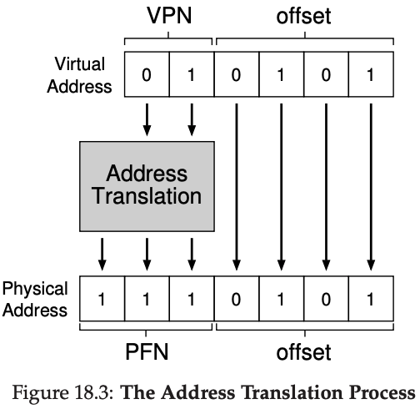
Project 3: The Textbook Helps!

Slide 3
Project 3: Fun with Pointers
unsigned char memory[64];
//unsigned char *memory = (unsigned char *) malloc(64);
// 8 bits == 1 byte
struct page_table_entry {
u_int8_t physical_frame_number:2; // Range from 0 to 3
u_int8_t present:1; // 0 = absent, 1 = present
u_int8_t writable:1; // 0 = not writable, 1 writable
};
struct page_table_entry *page1entry, *page2entry;
page1entry = (struct page_table_entry *) memory;
page2entry = page1entry + 1; // Correct?

Slide 4
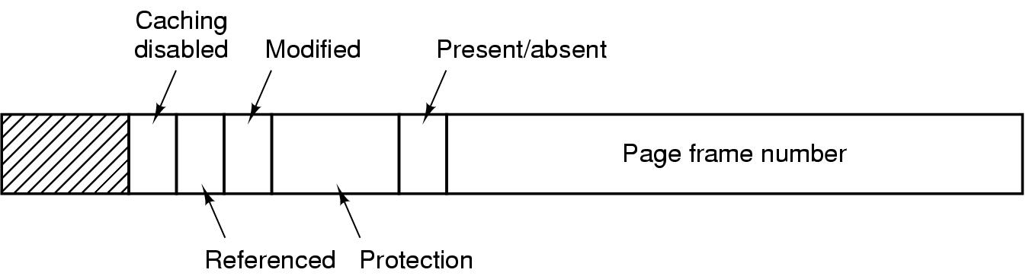
Structure of Page Table Entry

Slide 5
Paging – Advantages
Easy to allocate physical memory
pick (almost) any free frame
No external fragmentation
All frames are equal
Minimal internal fragmentation
Bounded by page/frame size
Easy to swap out pages (called pageout)
Processes can run with not all pages swapped in

Slide 6

Slumlord Shue’s Apartments

Slide 7
Definition — Page Fault
Trap when virtual address has valid bit=0 in page table
If page exists on disk:
Suspend process
Possibly evict another page (and update its PTE)
Swap in desired page, resume execution
If page does not exist on disk:
Return program error
Conjure up a new page and resume execution
Example: growing the stack

Slide 8
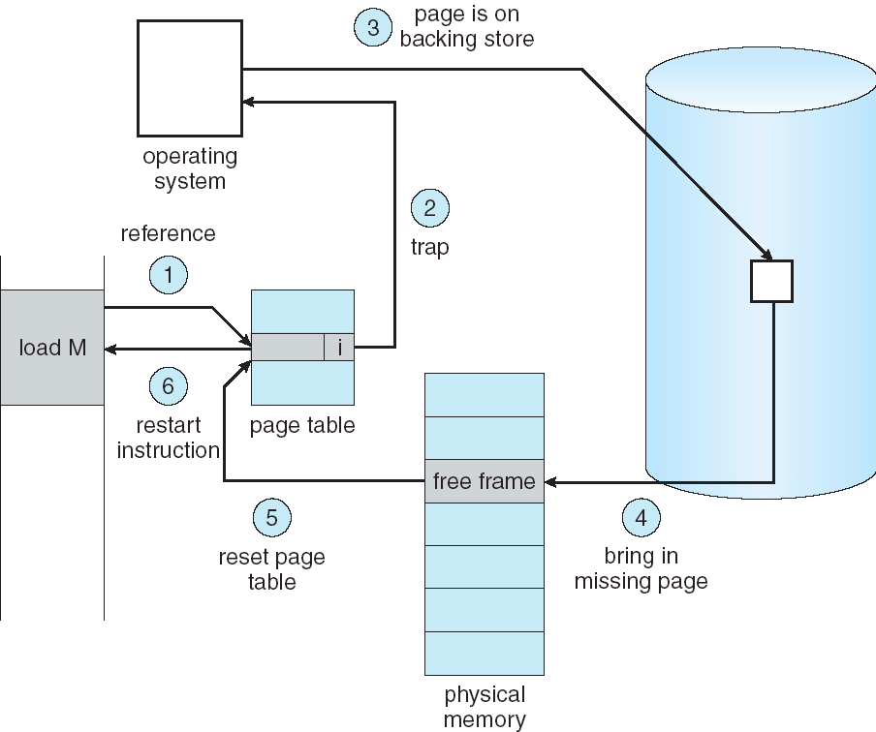
Steps in Handling a Page Fault

Slide 9
Definition — Backing Storage
A place on external storage medium where copies of virtual pages are kept
Usually a hard disk (locally or on a server)
Place from which contents of pages are read after page faults
Place where contents of pages are written if page frames need to be re-allocated

Slide 10
Requirement for Paging to Work!
Machine instructions must be capable of restarting
If execution was interrupted during a partially completed instruction, need to be able to
continue or
redo without harm
This is a property of all modern CPUs
but not of some older CPUs!

Slide 11
Protection Bits
Protection bits are important part of paging
A process may have valid pages that are
not writable
execute only
Setting PTE protection bits to prohibit certain actions is a legitimate way of detecting the first action to that page

Slide 12
Protection Bits (continued)
Definition of Page Fault is extended to include:
Trap when valid=0 in PTE
Access inconsistent with protection setting

Slide 13
Observations and Definitions
Recurring themes in paging
Temporal Locality: locations referenced recently tend to be referenced again soon
Spatial Locality: locations near recent references tend to be referenced soon
Definitions
Working set: The set of pages that a process needs to run without frequent page faults
Thrashing: Excessive page faulting due to insufficient frames to support working set

Slide 14
Paging Issues
Page Tables can be huge
32bit: 4KB pages x 4-byte PTEs = 4MB (per process)
Stored in main memory
64bit: ☹
Performance is important
Virtual -> Physical requires multiple memory operations
Obtain Page Table Entry from memory
Get page frame number
Construct physical address
Assorted protection and valid checks
Fast hardware support needed to reduce memory accesses and validation checks

Slide 15
Issue #1: Page Table Size
Process Virtual Address spaces
Not usually full – don’t need every PTE
Processes exhibit locality – just a subset needed
Two-level page tables
Virtual Addresses have 3 parts
Master page number – points to secondary page table
Secondary page number – points to PTE containing page frame #
Offset
Physical Address = offset + startof(PFN)

Slide 16
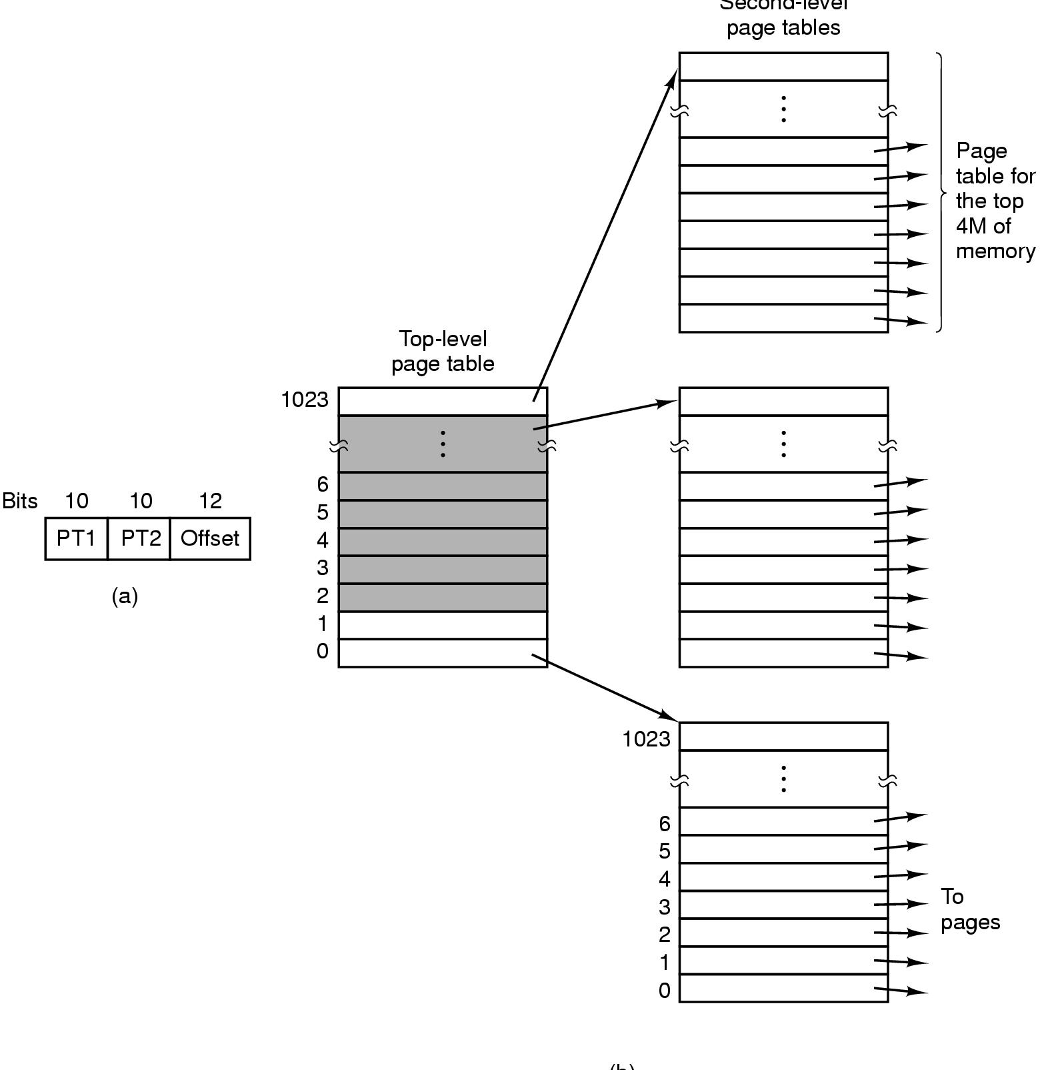
Multilevel Page Tables

Slide 17
Two-level page tables
12 bits
8 bits
12 bits
virtual address
master page #
secondary page#
offset
physical memory
page
frame 0
master
page table
physical address
page frame #
offset
page
frame 1
secondary
page table #
secondary
page table # addr
page
frame 2
page
frame 3
page frame
number
…
page
frame Y

Slide 18
Multilevel Page Tables
Sparse Virtual Address space – very few secondary PTs ever needed
Process Locality – only a few secondary PTs needed at one time
Can page out secondary PTs that are not needed now
Don’t page Master Page Table
Save physical memory
However
Performance is worse
Now have 3 (or more) memory accesses per virtual memory reference or instruction fetch
How do we get back to about 1 memory access per VA reference?
Problem #2 of “Paging Issues” slide

Slide 19
Issue #2: Performance
Translation Looksaside Buffer
Also: Associative Memory
Also: Dynamic Address Translation
Do fast hardware search of all entries in parallel for VPN
Present: Use page frame number from PTE
Else:
Look up in page table (multiple accesses)
Load VPN and PTE into Associative Memory (throwing out another entry as needed)
VPN #
PTE

Slide 20
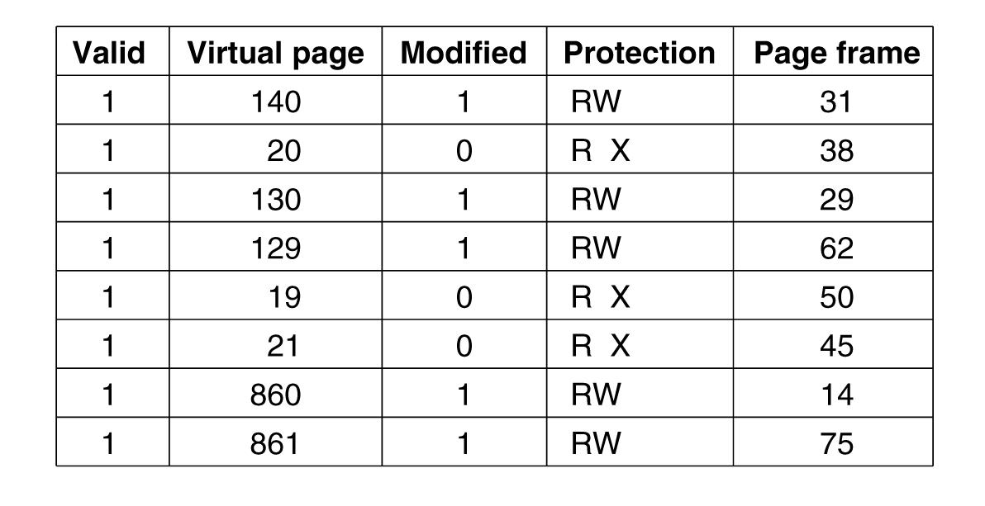
Translation Lookaside Buffers

Slide 21
Translation Lookaside Buffer (TLB)
Associative memory implementation in hardware
Translates VPN to PTE (containing PFN)
Done in single machine cycle
TLB hardware assist
Fully or partially associative – entries searched in parallel with VPN as index
Returns page frame number (PFN)
MMU use PFN and offset to get Physical Address
Locality makes TLBs work
Usually have 8–1024 TLB entries
Sufficient to deliver 99%+ hit rate (in most cases)
Works especially well with multi-level page tables

Slide 22
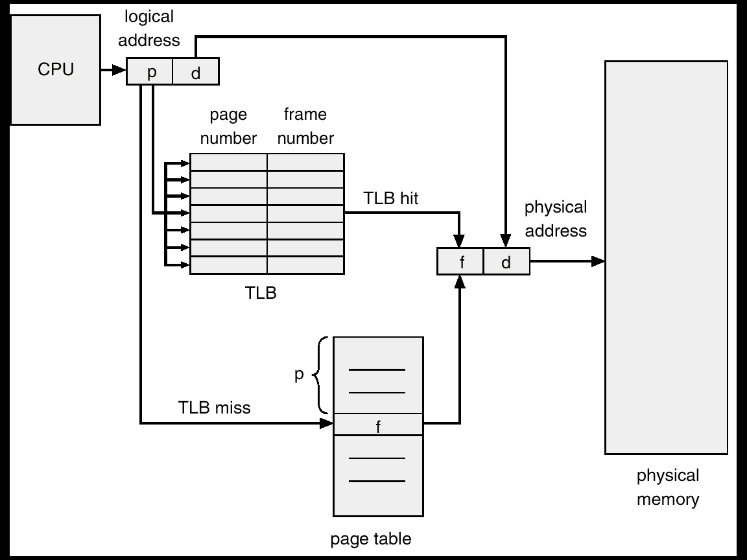
MMU with TLB

Slide 23
Typical Machine Architecture
CPU
MMU and TLB live here
Memory
Memory
Memory
Bridge
Graphics
I/O device
I/O device
I/O device
I/O device

Slide 24
TLB-related Policies
OS must ensure that TLB and page tables are consistent
When OS changes bits (e.g. protection) in PTE, it must invalidate TLB copy
Dirty bit and reference bits in TLB must be written back to PTE
TLB replacement policies
Random
Least Recently Used (LRU) – with hardware help
What happens on context switch?
Each process has own page tables (possibly multi-level)
Must invalidate all TLB entries
Then TLB fills up again as new process executes
Expensive context switches just got more expensive!
Note benefit of Threads sharing same address space

Slide 25
Hashing Page Tables
Common in address spaces > 32 bits.
The virtual page number is hashed into a page table.
Each entry contains a chain of VPN’s with same hash
Search chain for match
If found, use associated PTE
Still needs TLB for performance

Slide 26
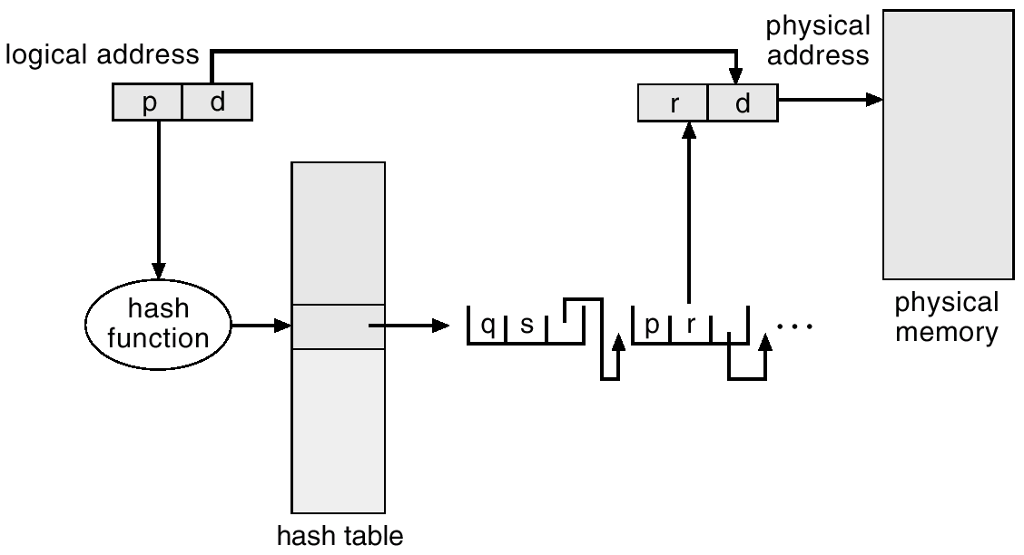
Hashed Page Tables

Slide 27
Inverted Page Tables
One entry for each real page of memory.
Entry consists of virtual address of page stored at that real memory location, with information about the process that owns that page.
Decreases memory needed to store each page table, but increases time needed to search the table when a page reference occurs.
Use hash table to limit the search to one or a few page-table entries.
Still uses TLB to speed up execution

Slide 28
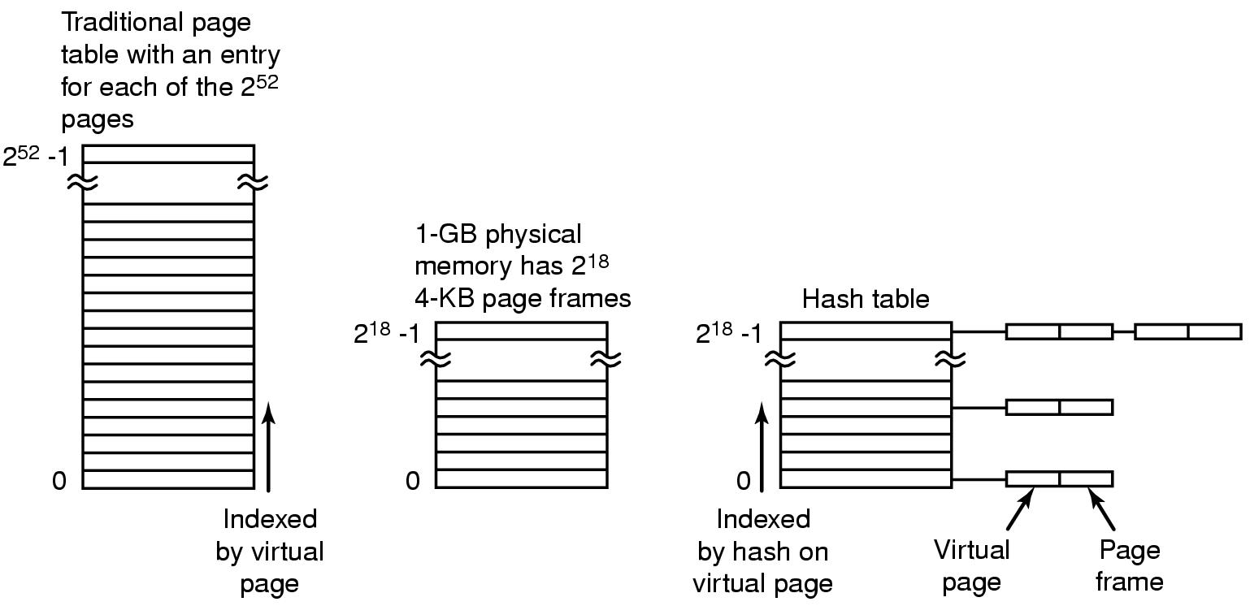
Inverted Page Tables

Slide 29
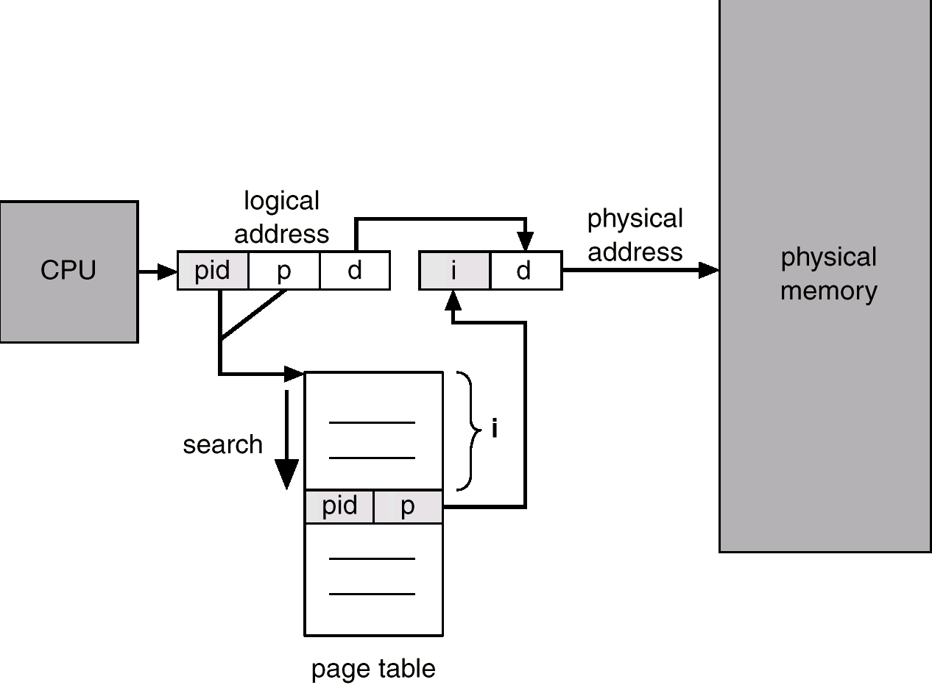
Inverted Page Table Architecture

Slide 30
Inverted Page Table Architecture
Apollo Domain systems
Common in 64-bit address systems
Supported by TLB
Next topic helps to quantify size of TLB

Slide 31
Silly Paging Tricks
Shared Memory
Copy on Write
Mapping Files to Virtual Memory

Slide 32
Shared Memory
Part of virtual memory of two or more processes map to same frames
Finer grained sharing than segments
Data sharing with Read/Write
Shared libraries with eXecute
Each process has own PTEs – different privileges

Slide 33
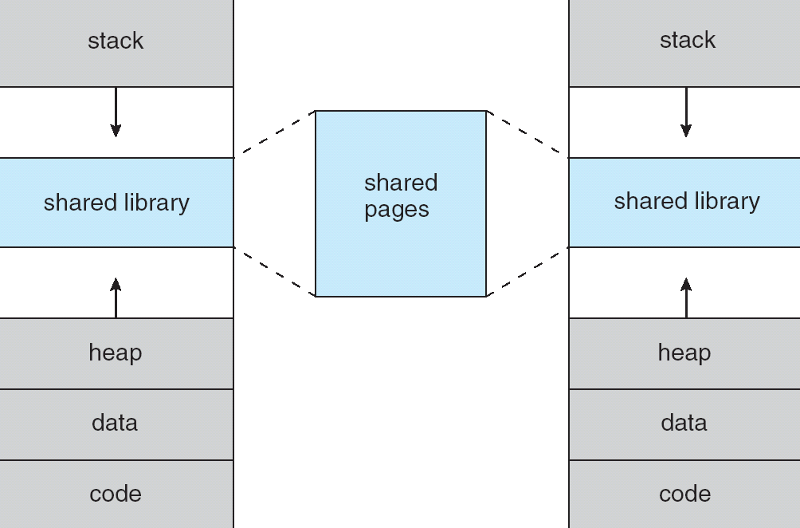
Shared Pages

Slide 34
Shared Pages
Widely used for libraries of code
Supported by most modern operating systems
Less widely used for sharing data memory
shmget(), etc.
Not always as same virtual address in each virtual memory — causes complications
Old gimmick serving same purpose as threads today

Slide 35
Paging trick – Copy-on-write
During fork()
Don’t copy individual pages of virtual memory
Just copy page tables; all pages start out shared
Set all PTEs to read-only in both processes
When either process hits a write-protection fault on a valid page that should be writable
Make a copy of that page, set write protect bit in PTE to allow writing
Resume faulting process
Saves a lot of unnecessary copying
Especially if child process will delete and reload all of virtual memory with call to exec()

Slide 36
Definition — Mapping
Mapping (part of) virtual memory to a file
≡ Assigning blocks of file as backing store for the virtual memory pages, so that
Page faults in (that part of) virtual memory resolve to the blocks of the file
Dirty pages in (that part of) virtual memory are written back to the blocks of the file

Slide 37
Warning — Memory-mapped Files
Tempting idea:
Instead of standard I/O calls (read(), write(), etc.) map file starting at virtual address X
Access to “X + n” refers to file at offset n
Use paging mechanism to read file blocks into physical memory on demand …
… and write them out as needed
Has been tried many times
Rarely works well in practice
Hard to program; even harder to manage performance

Slide 38
Virtual Memory – a Major OS Abstraction
Processes execute in virtual memory, not physical memory
Virtual memory may be very large
Much larger than physical memory
Virtual memory may be organized in interesting and useful ways
Virtual memory is where the action is!
Physical memory is just a cache of virtual memory

Slide 39
Discussion Questions
Are page frames limited to RAM? Can they exist on disk? Why or why not?
What is locality? Why is it important? What would need to change if locality stopped being common?
Does paging actually solve the fragmentation problem? Why or why not?

Slide 40

The End is Near

